Slide 1
Review of Linear Algebra
Dr. Chang Shu
COMP 4900C
Winter 2008

Slide 2
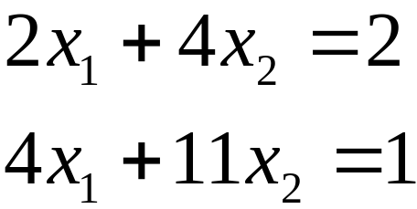
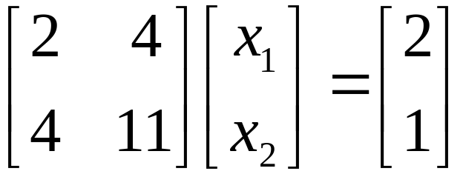

Linear Equations
A system of linear equations, e.g.
can be written in matrix form:
or in general:

Slide 3
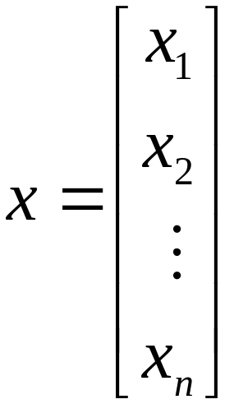
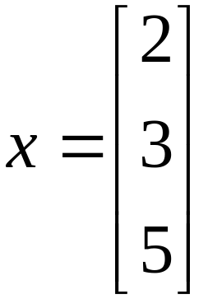
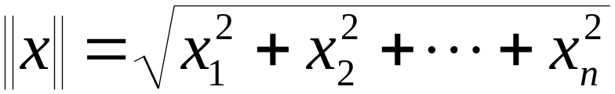
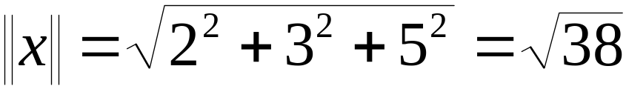
Vectors
e.g.
The length or the norm of a vector is
e.g.

Slide 4
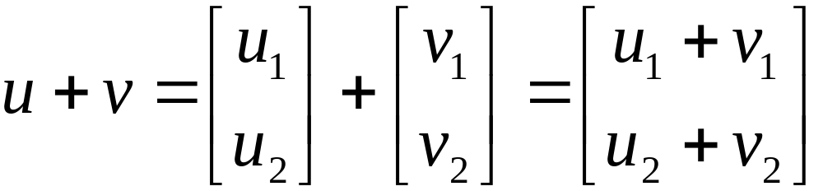
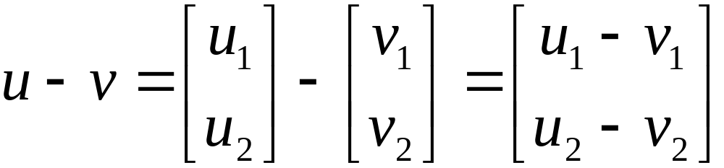
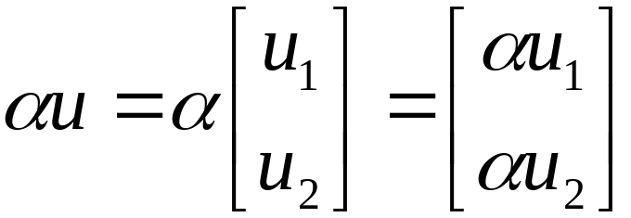
Vector Arithmetic
Vector addition
Vector subtraction
Multiplication by scalar

Slide 5
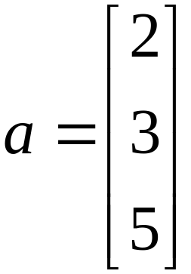
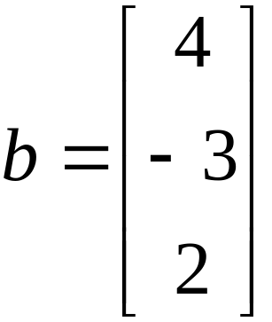
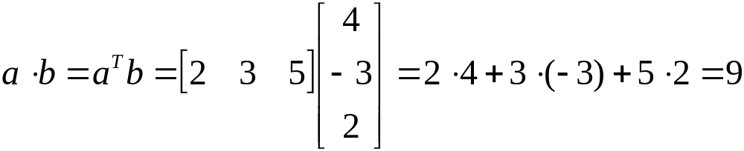
Dot Product (inner product)

Slide 6
Linear Independence
A set of vectors is linear dependant if one of the vectors can be expressed as a linear combination of the other vectors.
A set of vectors is linearly independent if none of the vectors can be expressed as a linear combination of the other vectors.

Slide 7
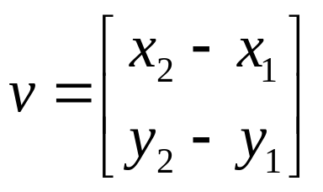
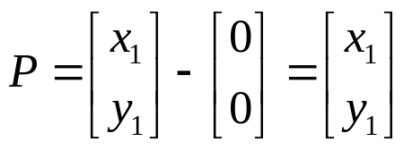
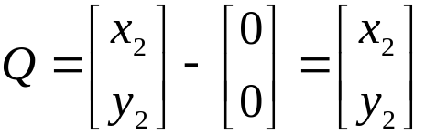
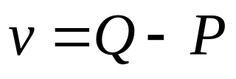
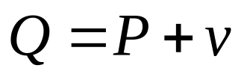
Vectors and Points
Two points in a Cartesian coordinate system define a vector
y
v
Q(x2,y2)
P(x1,y1)
x
A point can also be represented as a vector, defined by the point
and the origin (0,0).
y
v
Q(x2,y2)
P(x1,y1)
or
x
Note: point and vector are different; vectors do not have positions

Slide 8
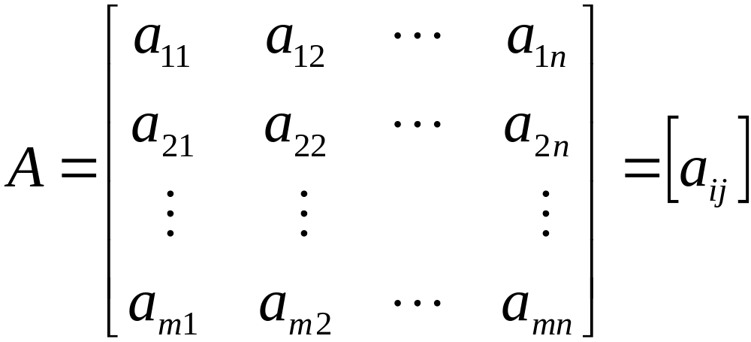
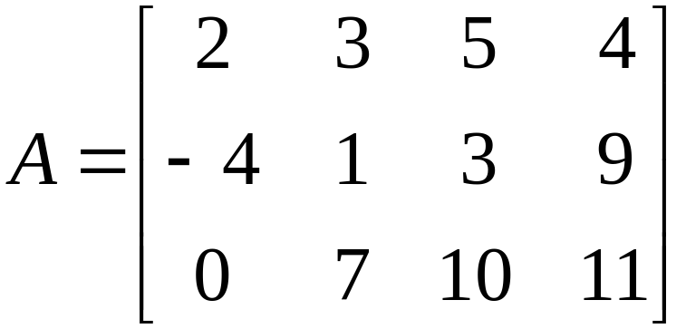
Matrix
A matrix is an m×n array of numbers.
Example:

Slide 9
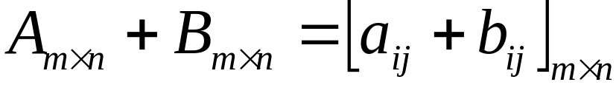
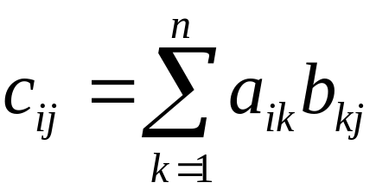
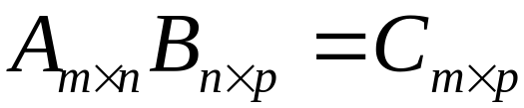
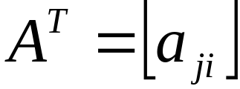
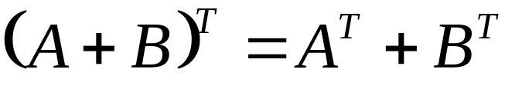

Matrix Arithmetic
Matrix addition
Matrix multiplication
Matrix transpose

Slide 10

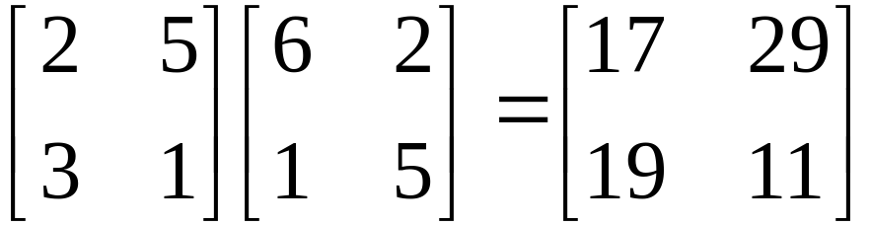
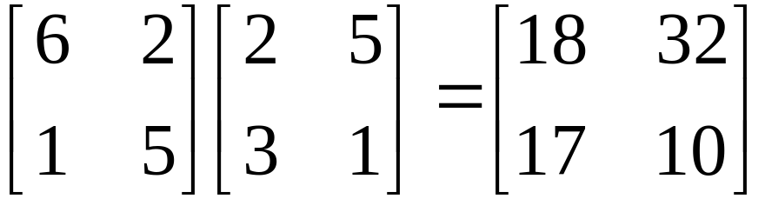
Matrix multiplication is not commutative
Example:

Slide 11

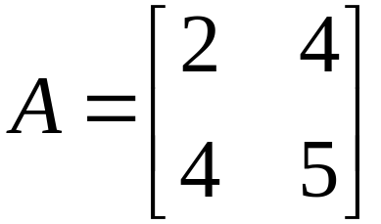
Symmetric Matrix
We say matrix A is symmetric if
Example:
A symmetric matrix has to be a square matrix

Slide 12


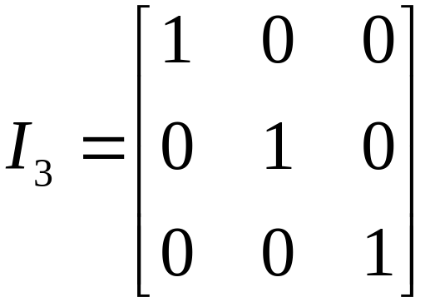
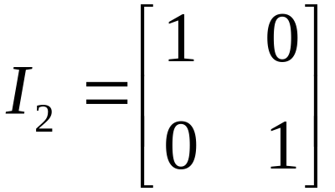
Inverse of matrix
If A is a square matrix, the inverse of A, written A⁻¹ satisfies:
Where I, the identity matrix, is a diagonal matrix with all 1’s
on the diagonal.

Slide 13
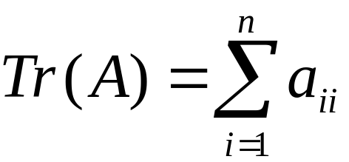
Trace of Matrix
The trace of a matrix:

Slide 14


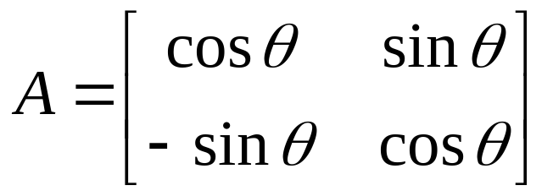
Orthogonal Matrix
A matrix A is orthogonal if
or
Example:

Slide 15
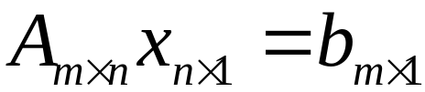
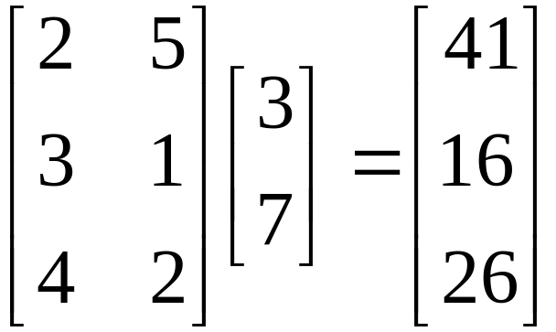
Matrix Transformation
A matrix-vector multiplication transforms one vector to another
Example:

Slide 16
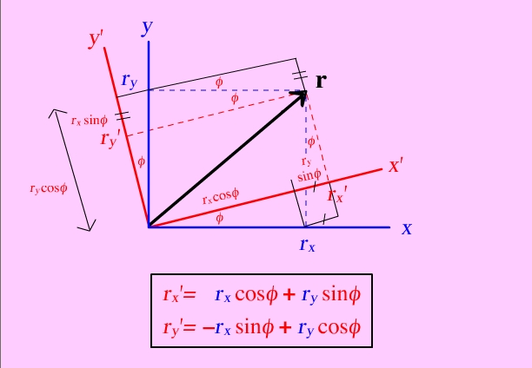
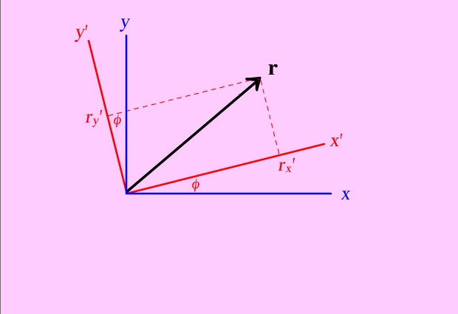
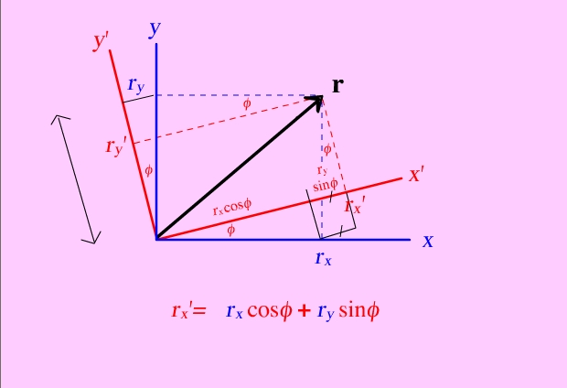
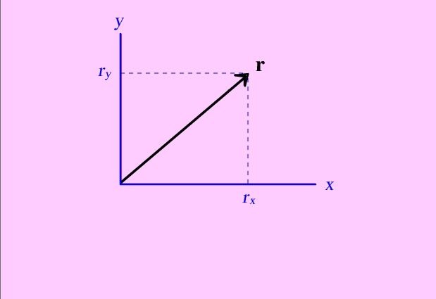
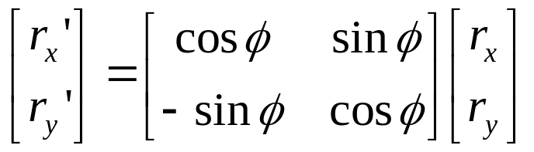
Coordinate Rotation

Slide 17


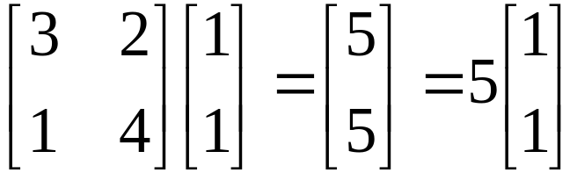
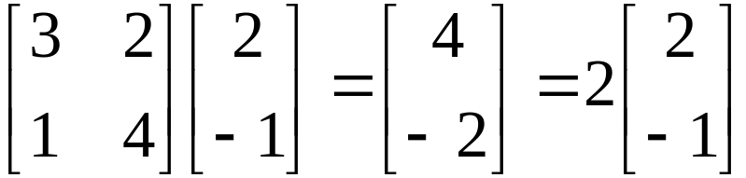

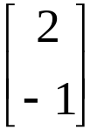
Eigenvalue and Eigenvector
We say that x is an eigenvector of a square matrix A if
λ is called eigenvalue and is called eigenvector.
The transformation defined by A changes only the
magnitude of the vector
Example:
and
5 and 2 are eigenvalues, and
and
are eigenvectors.

Slide 18
Properties of Eigen Vectors
If λ₁, λ₂,…, λ_{q} are distinct eigenvalues of a matrix, then the corresponding eigenvectors e₁,e₂,…,e_{q} are linearly independent.
A real, symmetric matrix has real eigenvalues with eigenvectors that can be chosen to be orthonormal.

Slide 19

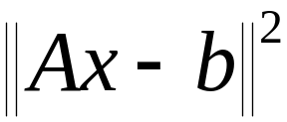
Least Square
When m>n for an m-by-n matrix A,
has no solution.
In this case, we look for an approximate solution.
We look for vector such that
is as small as possible.
This is the least square solution.

Slide 20


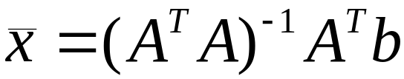
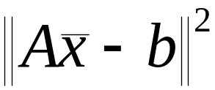
Least Square
Least square solution of linear system of equations
Normal equation:
is square and symmetric
The Least Square solution
makes
minimal.

Slide 21
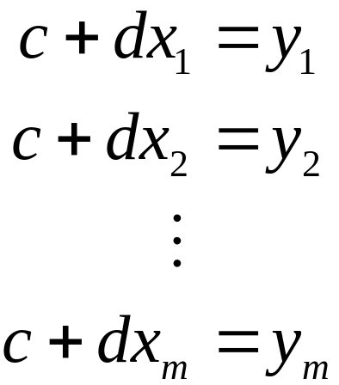
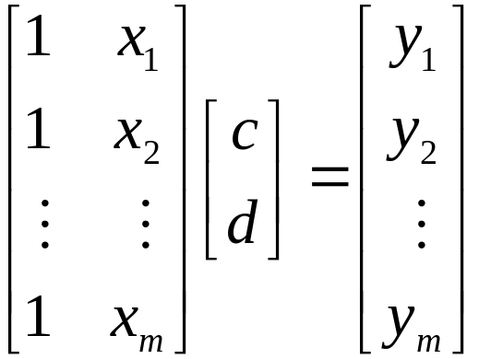

Least Square Fitting of a Line
Line equations:
y
x
The best solution c, d is the one that minimizes:

Slide 22
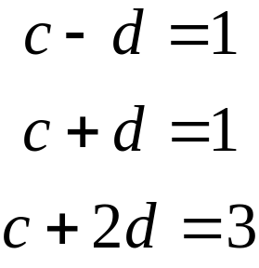
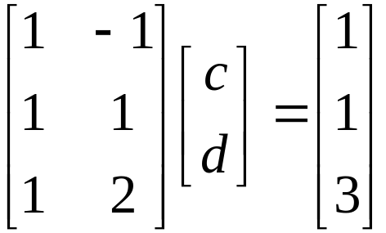
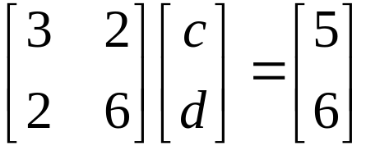


Least Square Fitting - Example
Problem: find the line that best fit these three points:
P1=(-1,1), P2=(1,1), P3=(2,3)
y
Solution:
or
x
is
The solution is and best line is

Slide 23

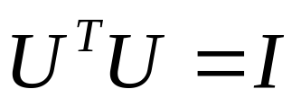


SVD: Singular Value Decomposition
An m×n matrix A can be decomposed into:
U is m×m, V is n×n, both of them have orthogonal columns:
D is an m×n diagonal matrix.
Example:

